Slide 1
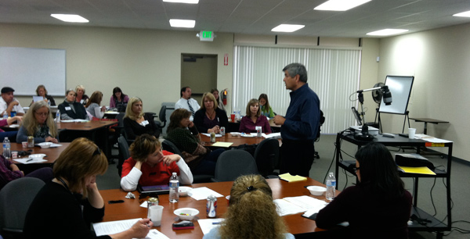
FRAMING~”Our Message ~ Our Voice”
Poway Federation of Teachers

Slide 2
BACKGROUND
Why does the public have such a low opinion of public education? California has gone from “First to Worst”!
Test Scores: U.S. students can’t compete against Asian and European countries, especially in math and science.
Federal School Reform Measures: A Nation At Risk, No Child Left Behind, and Race To The Top.

Slide 3
What’s standing in the way of
SCHOOL REFORM?
Public perception of a school system is the teacher. The teacher is their experience and a school system is complex.
As long as teachers are seen as the system, any failures in education are attributed to the teacher and his/her performance.
Public belief (value) is, “A good teacher is a teacher that cares.”

Slide 4
SOLUTION
The fix to school reform is to fix the teacher and eliminate teachers’ unions!
Make teachers care more!
Use test scores to make teachers care even more!!
Get rid of the bad teachers and you’ll fix education.
Unions protect bad teachers. Get rid of unions and you’ll get rid of bad teachers.

Slide 5
PROBLEM
When we attribute the success of teachers to inherent human traits (caring) then all the other factors that account for teacher development and effectiveness are hidden:
Teacher Preparation
Professional Development
Content Knowledge
Moves teachers away from a profession to a character trait.

Slide 6
FRAMING
A scientific method of communicating. Frames are mental structures that shape the way we see the world. When you hear a word, its frame is activated in your brain. For example,
“Government run schools are failing all our children.”

Slide 7

“GOVERNMENT RUN SCHOOLS ARE FAILING
ALL OUR CHILDREN”
Government = Bureaucratic, inefficient, lack of trust, expensive…
Government run schools = Public school
Failing = “F” for failure, report card and in life, loss of middle class, country in ruins…
All our Children = Our most precious resource, innocent, universal need to be protected…
The public has been bomb-barded with a personalized agenda that is narrow and well organized.

Slide 8
Framing and REFRAMING
Reframing is changing the way the public sees the world:
1. Always use “values” to build public support around social issues. Frame always trumps facts.
2. Our work is to identify our most deeply held values to develop, Our Message ~ Our Voice! (common message and talking points)
3. Simplify the Frame by identifying an image or relationship (metaphor).

Slide 9
PURPOSE OF FRAMING
“Our Message ~ Our Voice”
Political Power
Create a positive common message that all teachers believe and can sell to the public.
Create easy to remember talking points – gives power to teachers when they know how to respond.
Improve the image of public education and teachers. Change the conversation!
Teacher Evaluation Tool
Engage teachers in identifying and developing what they believe is important in a new teacher/principal evaluation tool.
What defines a Quality Teacher?
What are the skills and knowledge students need to know?
Who is should be held accountable?

Slide 10
PROCESS FOR FRAMING
“Our Message ~ Our Voice”
STEP 1. Identifying our values
  Teacher Survey
  Rep Council analysis of survey responses
  Facebook Dialog and 2nd Teacher Survey
  Rep Council Recommendation
  Site Visits
  Made an effort to engage all teachers during the process.

Slide 11
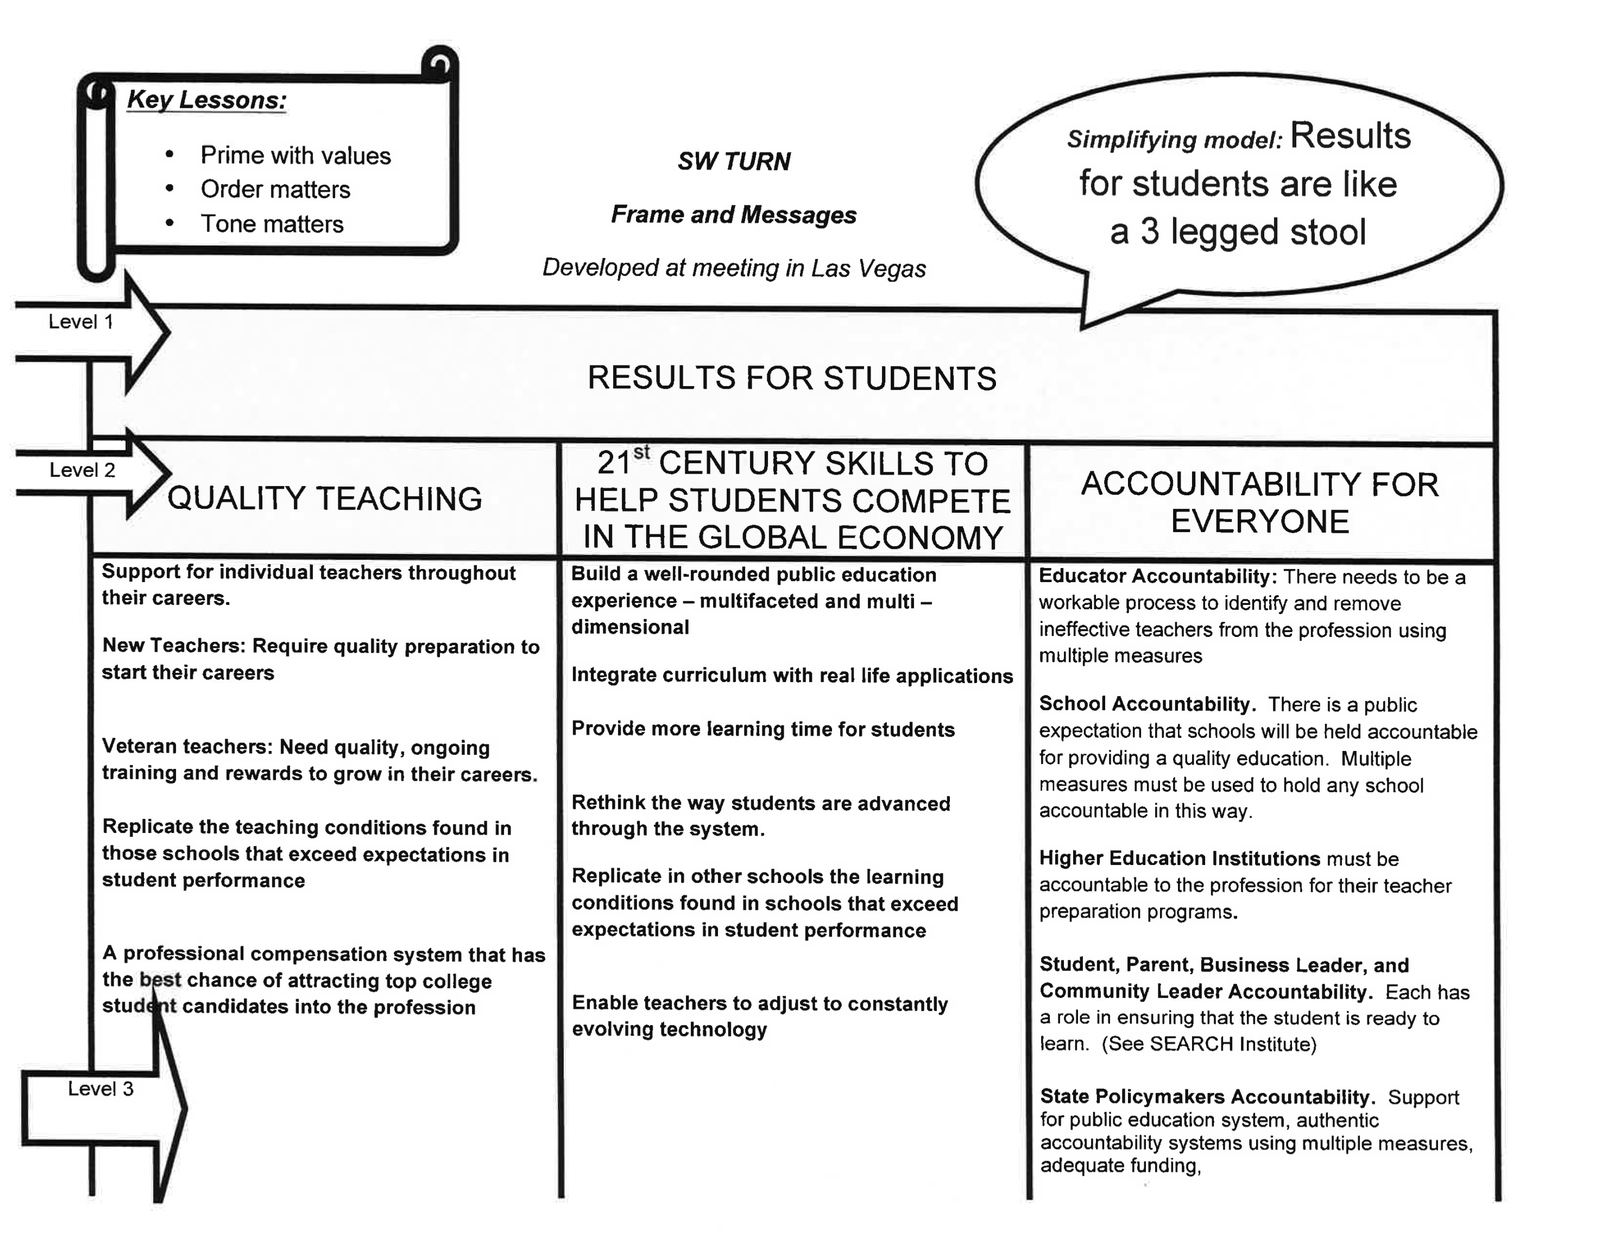
Step 2. Frame Your Values

Slide 12
Step 3. Simplify your frame by identifying an image or relationship

Slide 13
REFRAMING “Our Message ~ Our Voice”
“If teachers and teacher unions cared about students they wouldn’t care about the money.”
REFRAME
Caring about students is important but we must also get results for students. We must have a quality teacher in every classroom to get results for students. To attract and retain the best and brightest teachers schools must provide competitive salaries and provide teachers with the resources they need to ensure our students acquire 21st C. skills. Teachers, parents, teacher unions, legislators…must all be held accountable to provide the funding we need to ensure we get results for students!

Slide 14
CONCLUSION
“We internalize and practice our message and this becomes our public fact. This is how we market ourselves.”
When and How to use this framework:
Responding to your neighbor’s statement, “Public school problems are too big to fix.”
In support and response to November’s Ballot Initiatives around school funding.
Creating our own Teacher Evaluation Tool.

